Slide 1
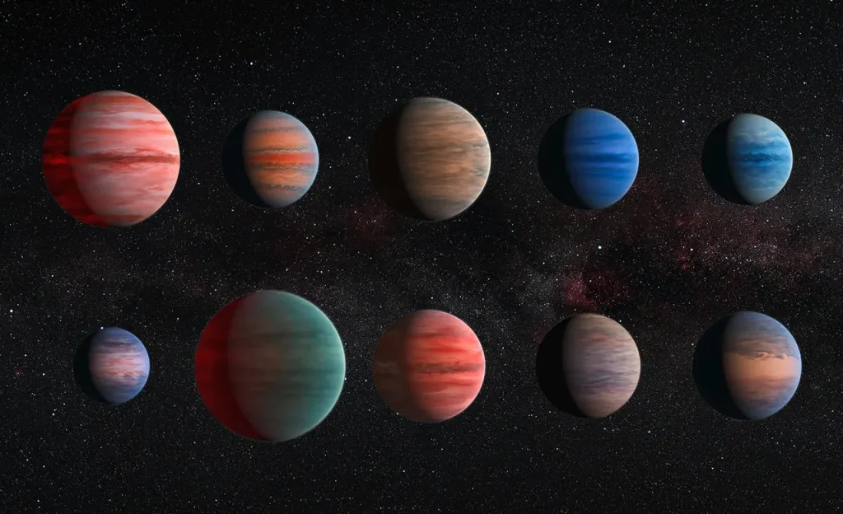
NASA Exoplanet Exploration
Different planetary/spatial data
Ranges from measured facts to information about discovery/researchers
Could try to predict planet mass/gravity/other planetary factors or other interesting facts (controversial?)
Current Team
Michael Owens
Lance Fowler
Jack Silkaitis
???
Could be classification, more likely to be regression
https://exoplanetarchive.ipac.caltech.edu/cgi-bin/TblView/nph-tblView?app=ExoTbls&config=PS
(39537,288)
Notes:
https://science.nasa.gov/gallery/exoplanets/

